Slide 1

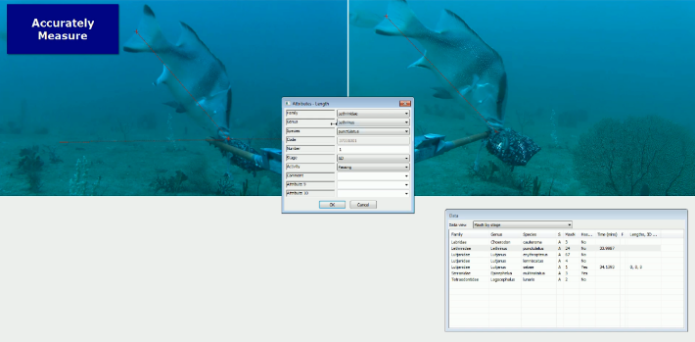










National/Institutional
portal/db
SyncTOOL
GlobalArchive
CheckEM
TPAC
SOP
Fieldwork

Slide 2
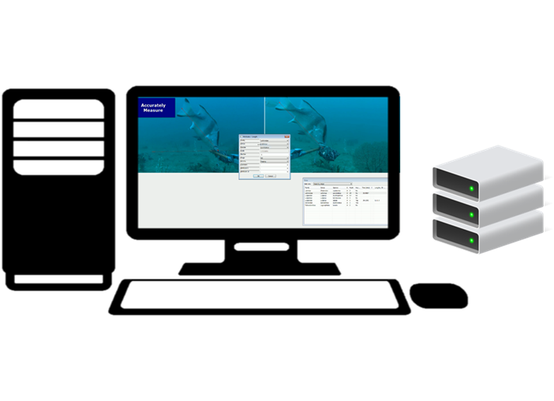
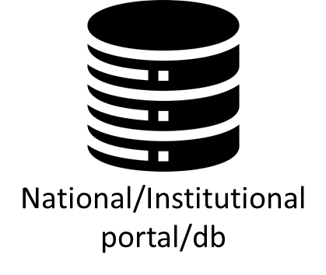
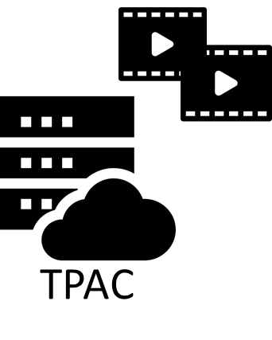





Slide 4
